Slide 1
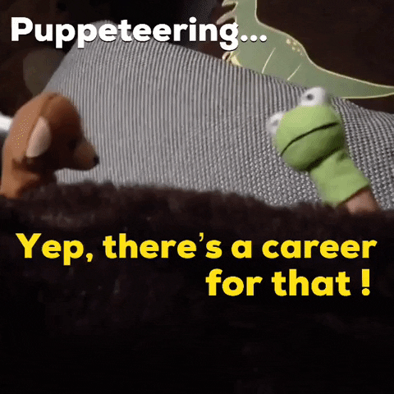

Making the call
Making the right decision when changing jobs in Cyber.

Slide 2
Engagement : Talk Outline
Introduction: /whoami /ipconfig all
Your career: Short term vs Medium Term vs Long Term Career decisions
Questions: Ask away!
TIME: ~ 15min Talk / 5min Questions

Slide 3

Making the call
Introduction
/whoami /ipconfig all

Slide 4

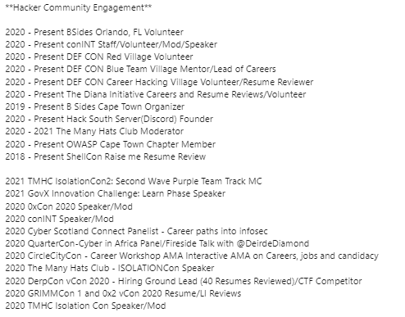
Introduction – $ career/ ls -a
Charles H Wroth
*6 Years: Former British Airborne (3 PARA) UK
*6 Years :High Risk Security Advisor (PhysSec)
*3 Years: Technical Security Recruiter (Redherd.io)
-Technically advanced security hiring (USA, UK, RSA)
-B Sides Cape Town Co-Organizer (Logistics)
-Def Con RTV Volt, BTV Staff, CaHV Volt
-Founder of Hack South Cyber Community
/hacksouth.africa

Slide 5




Slide 6

Making the call
The offer
Factors to think about when getting an offer.

Slide 7
Making the call: What to consider (Overview)
Points to consider before accepting a offer
Your skills and abilities?
Ethics/culture?
Team Cohesion
The Offer
Short term gain?
Medium Term
Long term gain
Notes:
Go into detail on first 3, skim over last 3

Slide 8
What to Consider: The basics
Does the job fit my skills and abilities?
Does the company match my ethics/culture?
Do I get on with the teammates, line manager and higher ups?
Do I truly believe I will be successful in this role and deliver according to my pay scale?
Notes:
Fit my skills and abilities
Do I fit the role, and does it fit me? Can I do this?
Ethics/culture
How do I feel about the atmospherics of the company?
Do their values align to mine? Can I adjust to theirs?
Co-Workers/Colleagues
Can I see myself in the trenches with the people side by side, and my leaders at the front?
AGAIN/Fit
Do you trully feel, overall with everything above whether you will be successful. Make too big a jump, and fail, it will stay with you and knock your confidence.

Slide 9

What to Consider: The short term
Base Salary
Benefits
Perks
Travel/Location/Relocation
Notes:
What are we putting in our pockets? Medical, educational allowance etc Perks: Querky, staff discounts Travel (Costs, payment per km)

Slide 10
What to Consider: The Medium Term
What skills will I gain in this role
Experience can I build up with this new role?
What educational/research support will I get in this new role?
What exposure in the community will this role give me?
Def Con
Security BSides
IT Web Africa
Etc.
Notes:
SKILLS
Technical Skills
Soft Skills
People Skills
Client facing skills
Experience
Working in a field you wanted to
Exposure to new OS’s, new tools, new tech, a diff way of doing things? Educational Support
Is there any budget or funding for certs/research to that help me evolve and do my job better?
Community Exposure
Coy budget
Coy PTO
Leave
No support?

Slide 11
What to Consider: The Long Term
How will this job impact my career?
How will this title and company look on my resume/LinkedIn.
What value will I gain from the people I meet at this company (Networking).
Does this job lead me closer to my career goals?
Notes:
What value will this job bring to my career?
The overall package, the all in consideration.
How will this job impact my career?
When I look for the next one, or the next one comes knocking
How will this title and company look on my resume/LinkedIn.
Aesthtetics Matter.
Value Add vs Value Deduct (Company name/brand awareness)
The title may matter (Diff companies calling the same thing something different)

Slide 12
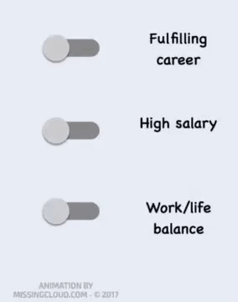

Making the call: Summary
The core aspects
The MONEY
The JOB
The RESUME
Notes:
In summary
When making the decision to accept an offer with a new company it is CRUCIAL to understand 3 basic factors. Note that these 3 parts cross pollinate the others. A symbiosis if you will.
Short Term? Money in the bank, quality of living, medical cover, etc
Mid Term-The Job: What is this job going to do for me? What skills will I learn. What ability will improve? What new challenges will I face and HOW WILL THIS AFFECT MY FUTURE.
The Long Term-YOUR RESUME: How will this look on my resume? What value does this bring to me. What happens if you take a high paying gig that slowly kills you inside, and then you quit? Do that too many times you kill your career as you become a risk hire.

Slide 13

Making the call – Concluded
E seun, mo ti pari

Slide 14
I Recruit Hackers
Questions!
Speak now or forever hold your peace

Slide 15

Thanks!
My talk:
My talk:

Slide 16




I Recruit Hackers
@AngusRedBlue
@hack_south
https://github.com/AngusRed
/in/chwroth/
HTB User/195578
Redherd.io
Socials
Find me!

